Slide 1
ANALOG DESIGN INTERNSHIP
MENTORS - Dr . GS Javed ( Technical Lead @ intel )
- Prof . Naushad Alam ( Department of Electronics Engg. ,AMU)
- Prof . Atiqur Rahman ( Department of Electronics Engg. ,AMU)
INTERN NAME - AFZAL MALIK
College/UNIVERSITY – ZAKIR HUSAIN COLLEGE OF ENGG. & TECH.
ALIGARH MUSLIM UNIVERSITY
COURSE- BACHELOR OF TECHNOLOGY (ELECTRONICS ENGG.)
YEAR – third

Slide 2
INTERNSHIP OBJECTIVES
Design and Simulation of CS Amplifier ( NMOS + Current Source )
Design and Simulation of Common Drain Amplifier
Design of Simple Current Mirror
CS Amplifier for Design of Differential Pair
Design and Simulation of Differential Pair
Design and Simulation of Single Stage OPAMP
Design and Simulation of Two Stage OPAMP
SOFTWARE USED : LT Spice , ADT (Analog Designer Toolbox)
TECHNOLOGY NODE : 180n
DESIGN METHODOLOGY : Gm over Id method

Slide 3
INTERNSHIP OVERVIEW
Week 1 to week 5

Slide 4
WEEK 1 INTERNSHIP OVERVIEW
Gained proficiency in LTspice for circuit analysis and design.
Used LTspice and MS Excel to plot parameter charts using
Gm over Id methodology.
Designed a Common Source Amplifier using the Gm over Id method.
Initial Design Constraints: No specific constraints, focused on understanding the design process.
New Design Constraint: Optimizing the W/L ratio for improved performance based on feedback

Slide 5
WEEK 2 INTERNSHIP OVERVIEW
Design constraint: Optimized W/L ratio in circuit design.
Designed Common Source Amplifier, Common Drain Amplifier
Simple Current Mirror, and Differential Pair using the Gm over Id
method.
Additional Design constraint: Designing circuits using unit devices.

Slide 6
WEEK 3 INTERNSHIP OVERVIEW
Design constraint: Optimized W/L ratio and using unit devices in circuit design
Designed Common Source Amplifier, Differential Pair, and Single-Stage Op Amp with GBW = 1GHz.
Designed a Two-Stage Op Amp with a gain > 60dB using the Gm over Id method

Slide 7
WEEK 4, 5
INTERNSHIP WORK

Slide 8

For designing circuits , NMOS AND PMOS parameter charts are required .
Here , ADT is used to generate the Parameter Charts for NMOS and PMOS for 180nm Technology

Slide 9
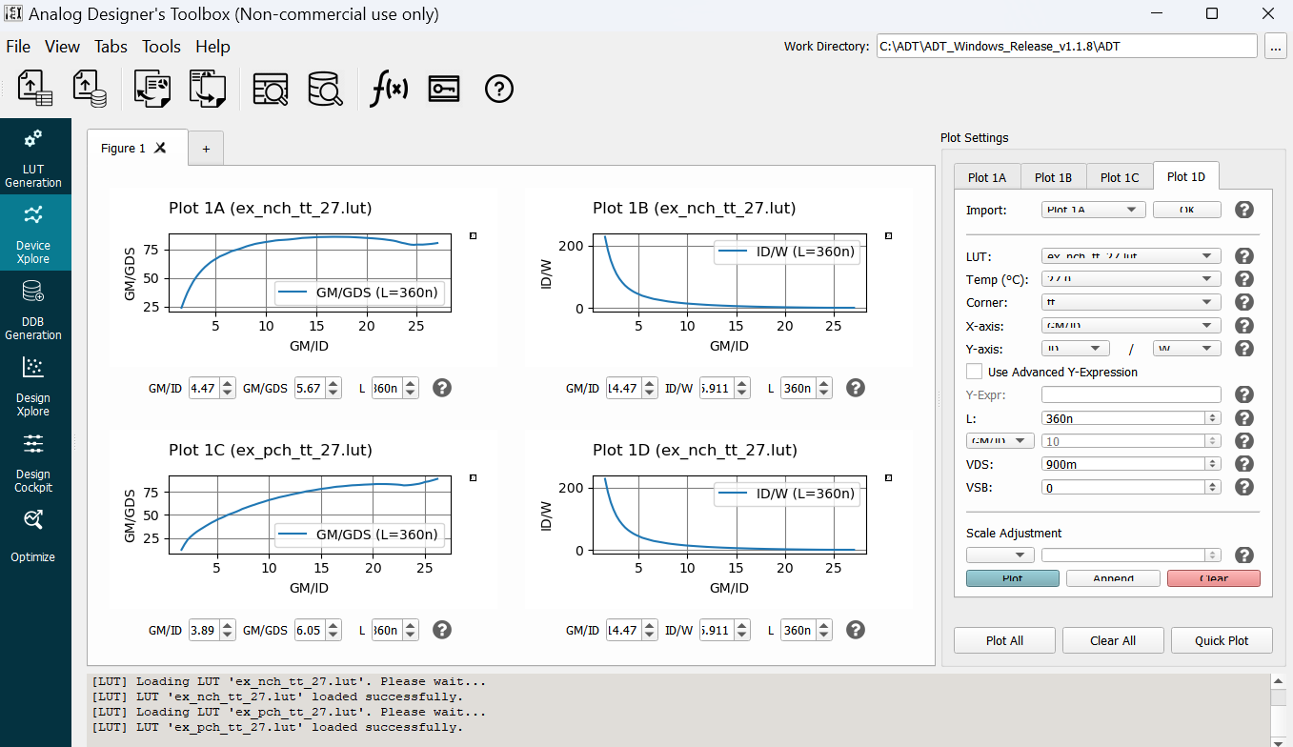

Slide 10
COMMON SOURCE AMPLIFIER using Gm over Id Method
Using nMOS AND CURRENT SOURCE LOAD
Model file : 180n
SPECIFICATIONS
GBW=1GHz , Gain =10 at 100MHz

Slide 11

CALCULATIONS
GBW=1GHz , Gain =10 at 100MHz
Let $Gm$= 2mS (Assumed ) CL= $\frac{Gm}{2π 1Ghz}$ = 0.27pF
Taking $\frac{Gm}{Id}=12$ Id = $\frac{2mS}{12}$ = 166.67uA = 167uA
For NMOS : (From Look Up Tables in ADT)
For $\frac{Gm}{Id}=12$ , $\frac{Gm}{Gds}=83.71$ , $\frac{Id}{W}=9.356$ , Vgs=0.6238
Hence , Gds= $\frac{2mS}{83.71}$ = 23.892uS W= $\frac{167u}{9.356}$ =17.84.u (Taken 17.82u)
For PMOS : (From Look Up Tables in ADT)
From Id vs Gm/Id graph , AT Id=167uA , Gm/Id=8.989 Hence , Gm=1.5mS
For $\frac{Gm}{Id}=8.989$ , $\frac{Gm}{Gds}=62.51$ , $\frac{Id}{W}=4.801$ , Vsg=0.6798
Hence , Gds= $\frac{1.5mS}{62.51}$ = 23.9uS W= $\frac{167u}{4.801}$ =34.784u (Taken 34.74u)
And , Vb = 1.8 – 0.6798 = 1.1202 Rout = 20.924K

Slide 12
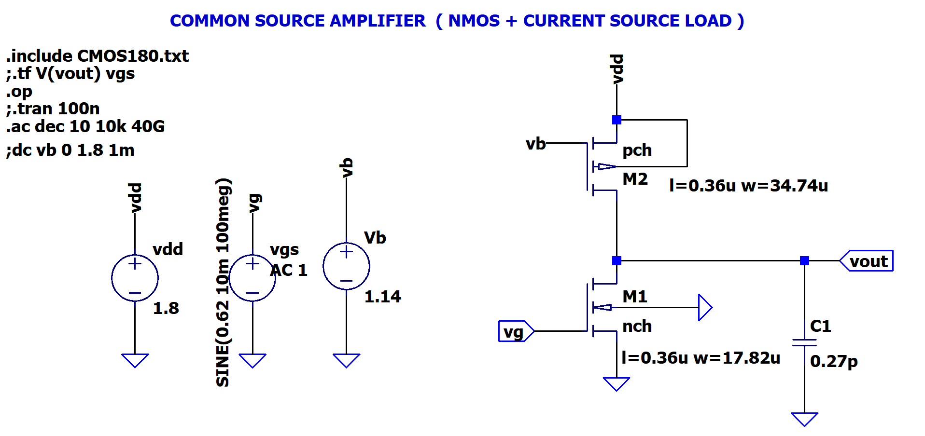
SCHEMATIC IN LT SPICE

Slide 13
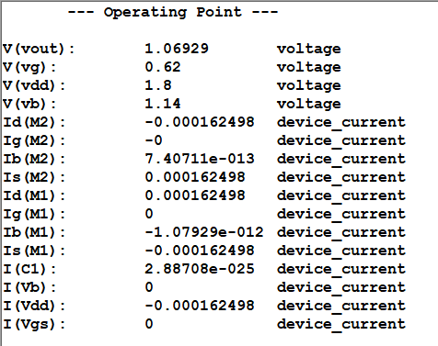
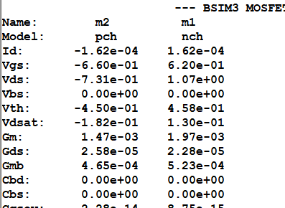
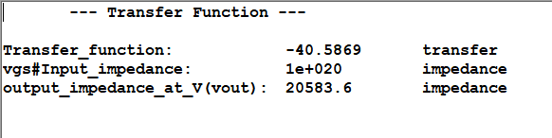
SPICE ERROR LOG & TRANSFER FUNCTION

Slide 14
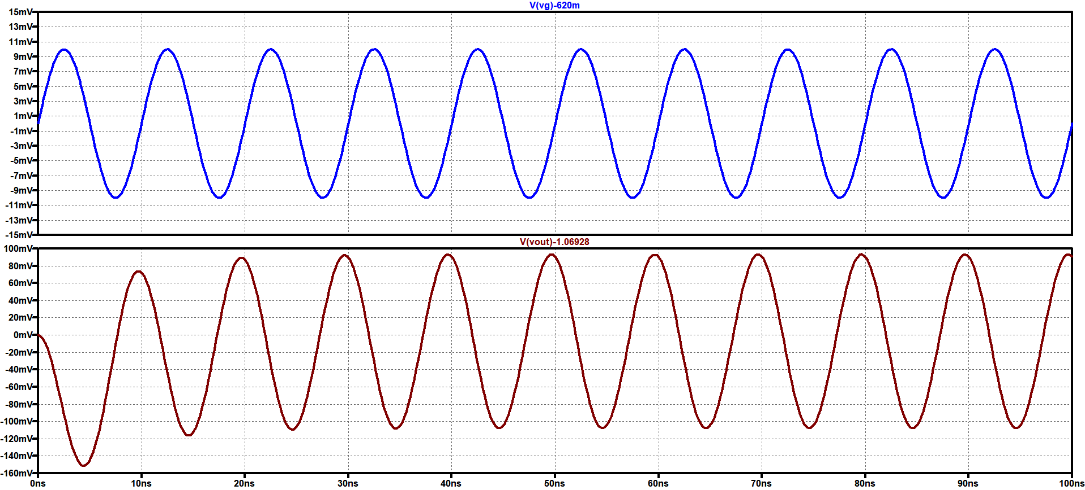
TRANSIENT ANALYSIS
Gain =10 at 100MHz , Input given is 10mV

Slide 15
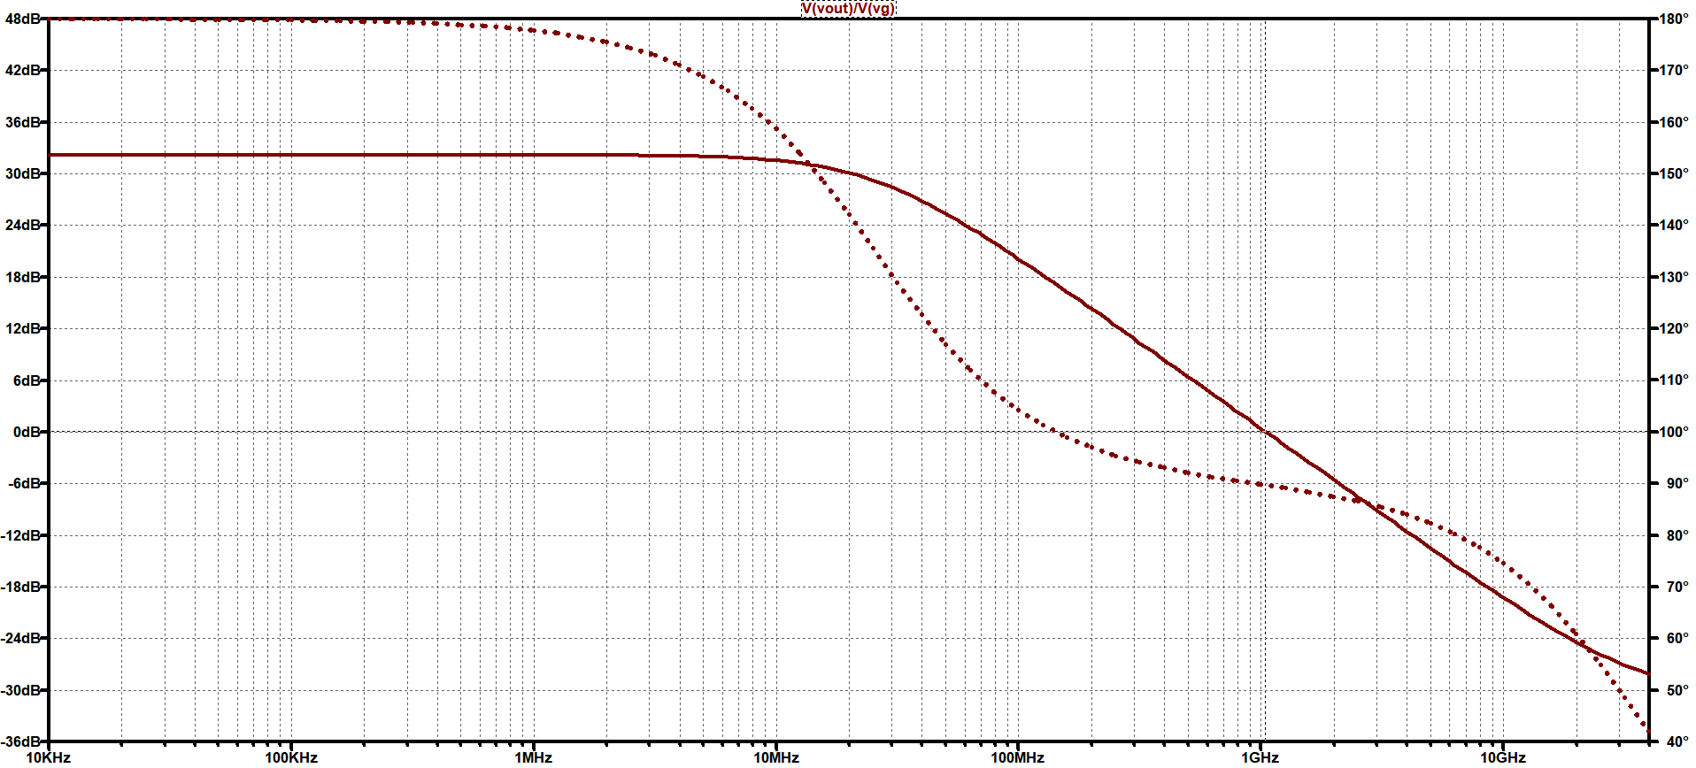
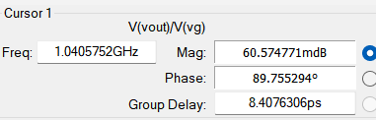
AC ANALYSIS
Gain ( In Decibel )
GBW=1.04 GHz
Frequency

Slide 16
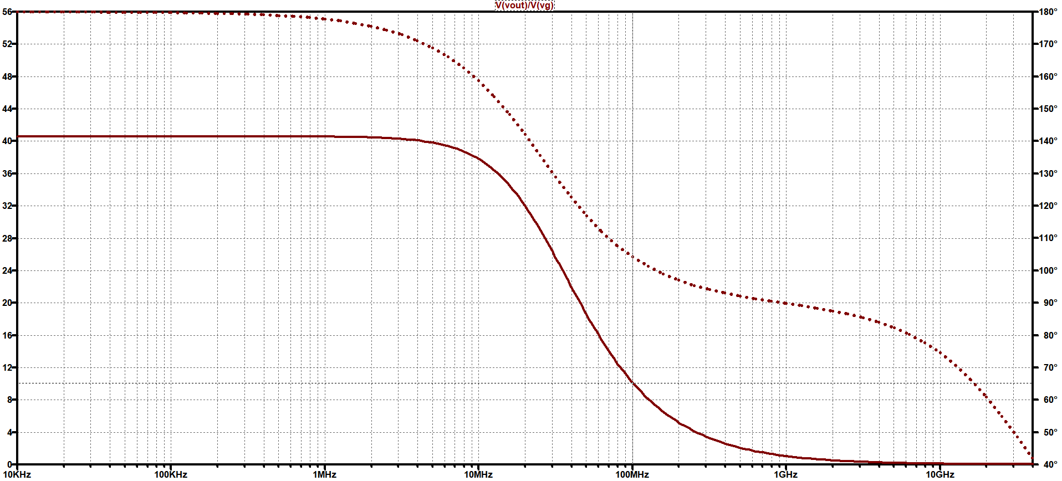
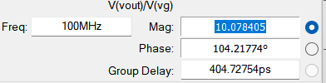
AC ANALYSIS
Gain ( In Volts/Volts )
Gain 10.07 at 100MHz
Frequency

Slide 17
SUMMARY OF DESIGN OF CS AMPLIFIER
SPECIFICATION | SIMULATION RESULTS
At 100MHz , Gain=10 | At 100MHz , Gain=10.07
GBW=1GHz | GBW=1.04GHz

Slide 18
COMMON SOURCE AMPLIFIER for Design of Differential Pair
Using nMOS AND CURRENT SOURCE LOAD
Model file : 180n
SPECIFICATIONS
GBW=1GHz , Gain =10 at 100MHz

Slide 19

CALCULATIONS
GBW=1GHz , Gain =10 at 100MHz
Let $Gm$= 2mS (Assumed ) CL= $\frac{Gm}{2π 1Ghz}$ = 0.29pF
Taking $\frac{Gm}{Id}=12$ Id = $\frac{2mS}{12}$ = 166.67uA = 167uA
For NMOS : (From Look Up Tables in ADT)
For $\frac{Gm}{Id}=12$ , $\frac{Id}{W}=9.913$ , Vgs=0.7417 hence Vg =1.1917
Hence , W= $\frac{167u}{9.913}$ =16.84u (Taken 16.92u)
For PMOS : (From Look Up Tables in ADT)
From Id vs Gm/Id graph , AT Id=167uA , Gm/Id=4.144 Hence , Gm=0.69mS
For $\frac{Gm}{Id}=4.144$ , $\frac{Id}{W}=16.7$ , Vsg=0.8743
Hence , W= $\frac{167u}{16.7}$ =10u (Taken 9.9u)
And , Vb = 1.8 – 0.8743= 0.9257

Slide 20
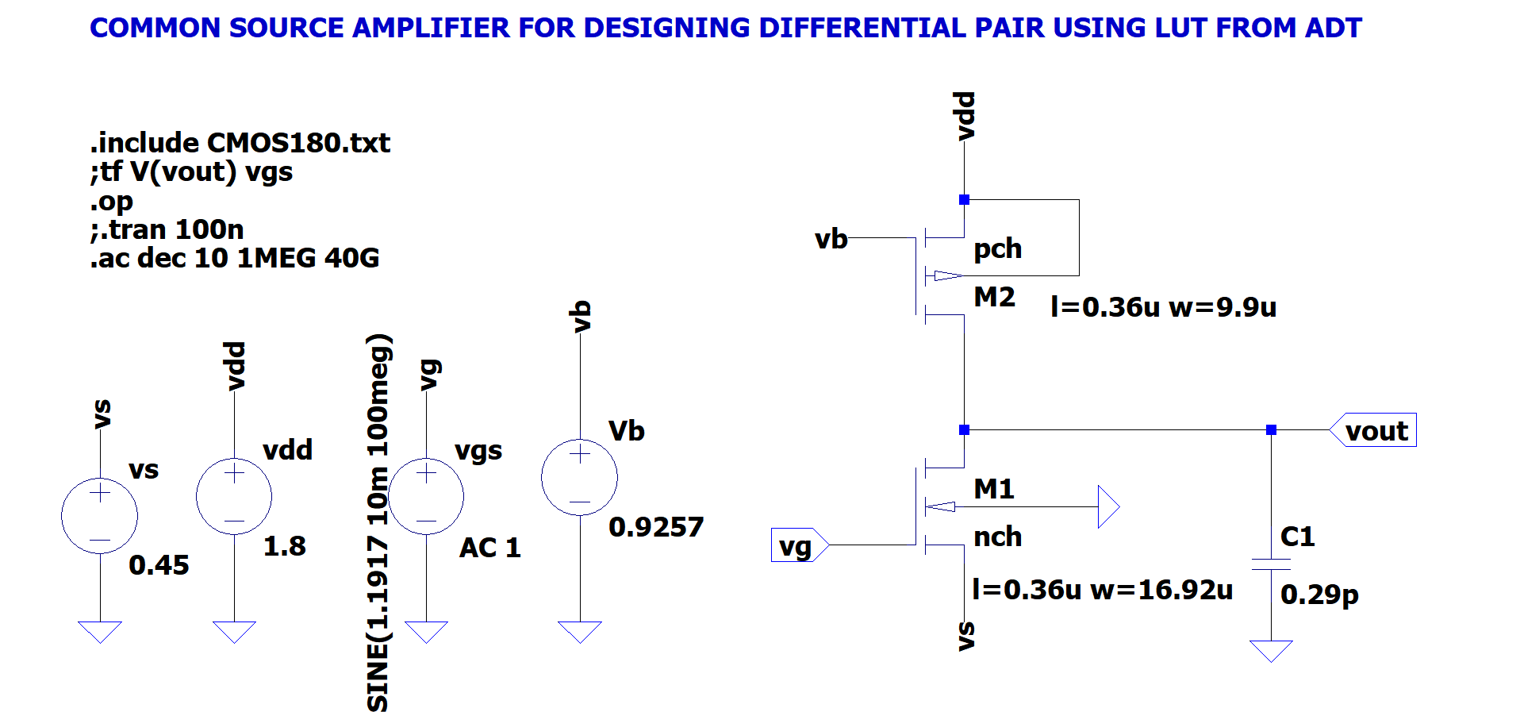
SCHEMATIC IN LT SPICE

Slide 21
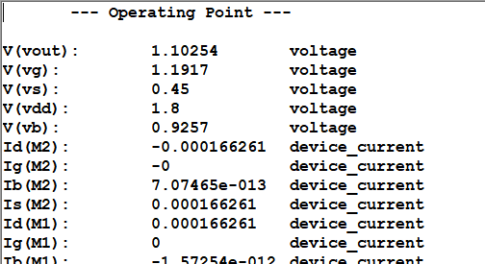
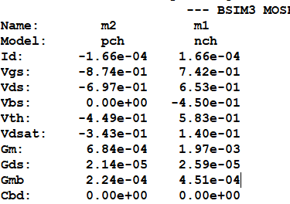
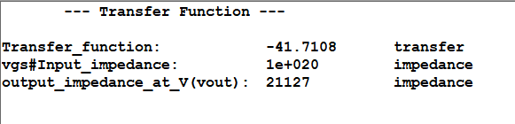
SPICE ERROR LOG & TRANSFER FUNCTION

Slide 22
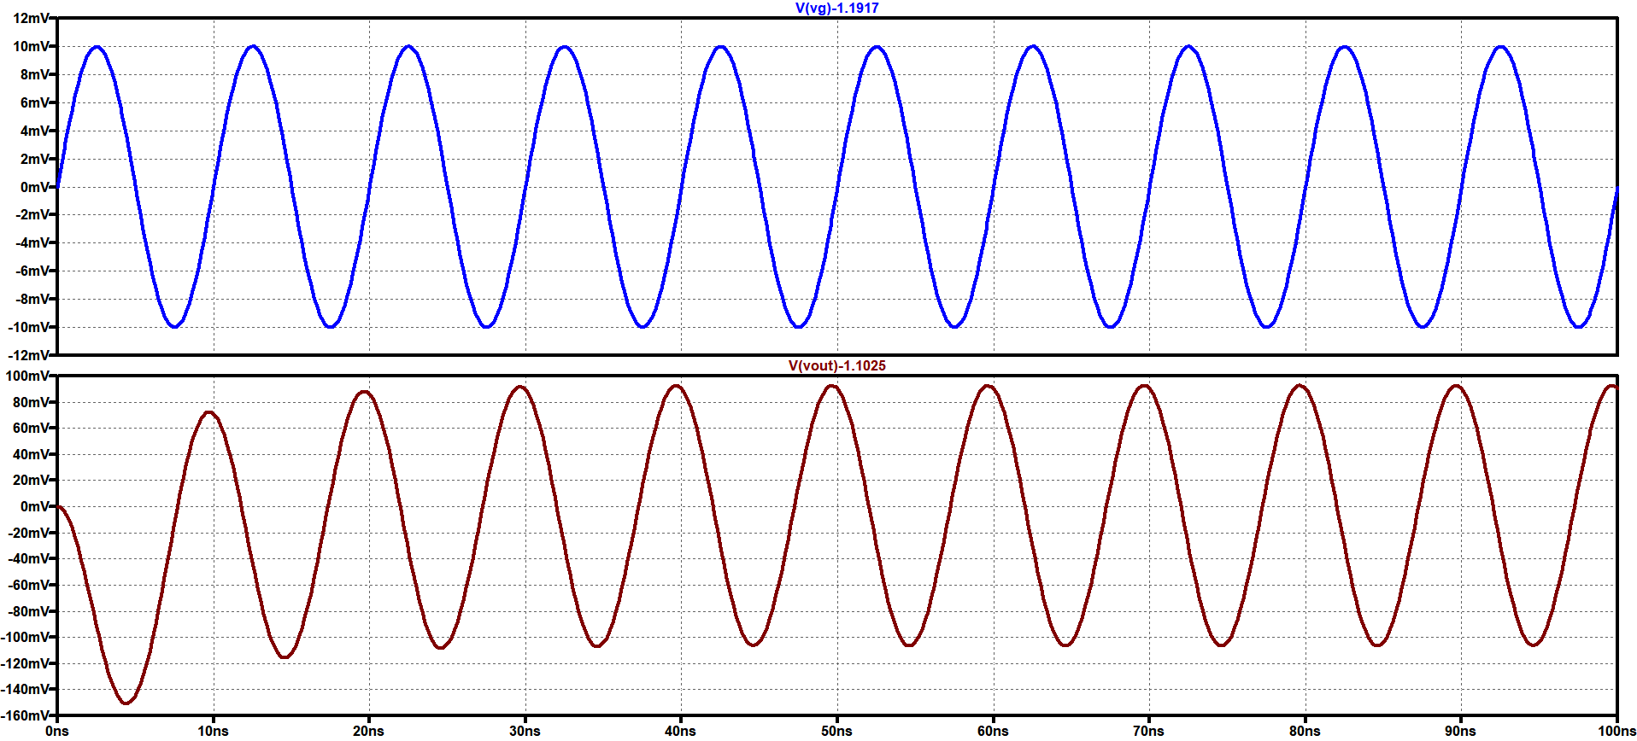
TRANSIENT ANALYSIS
Gain =10 at 100MHz , Input given is 10mV

Slide 23
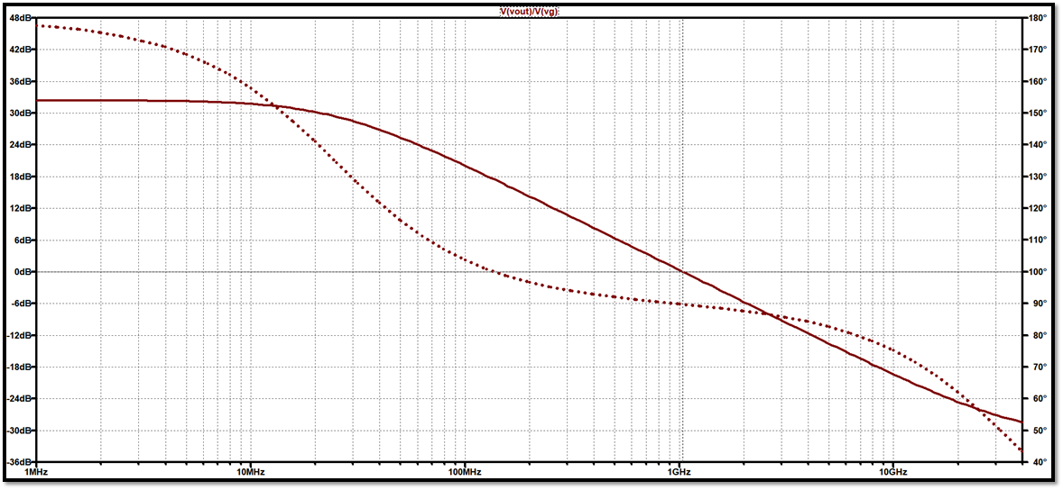
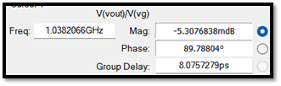
AC ANALYSIS
Gain ( In Decibel )
GBW=1.038 GHz
GBW=1.04 GHz
Frequency

Slide 24
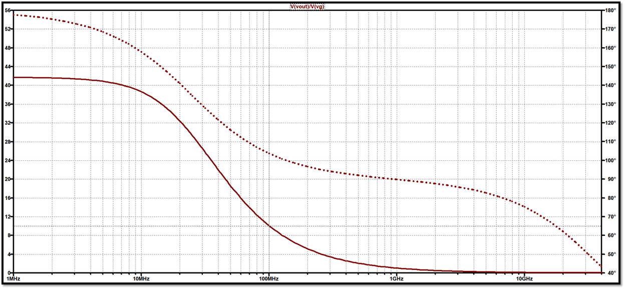
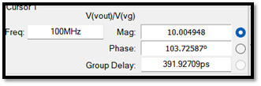
AC ANALYSIS
Gain ( In Volts/Volts )
Gain 10.07 at 100MHz
Gain 10.00498 at 100MHz
Frequency

Slide 25
SUMMARY OF DESIGN OF CS AMPLIFIER For Designing Differential Pair
SPECIFICATION | SIMULATION RESULTS
At 100MHz , Gain=10 | At 100MHz , Gain=10.004
GBW=1GHz | GBW=1.038GHz

Slide 26
DIFFERENTIAL PAIR DESIGN ( Gm over Id Method )
DESIGN AND SIMULATION using lt spice
Model file : 180n
SPECIFICATIONS
GBW= 1GHz
Gain = 10 at 100 MHz frequency

Slide 27
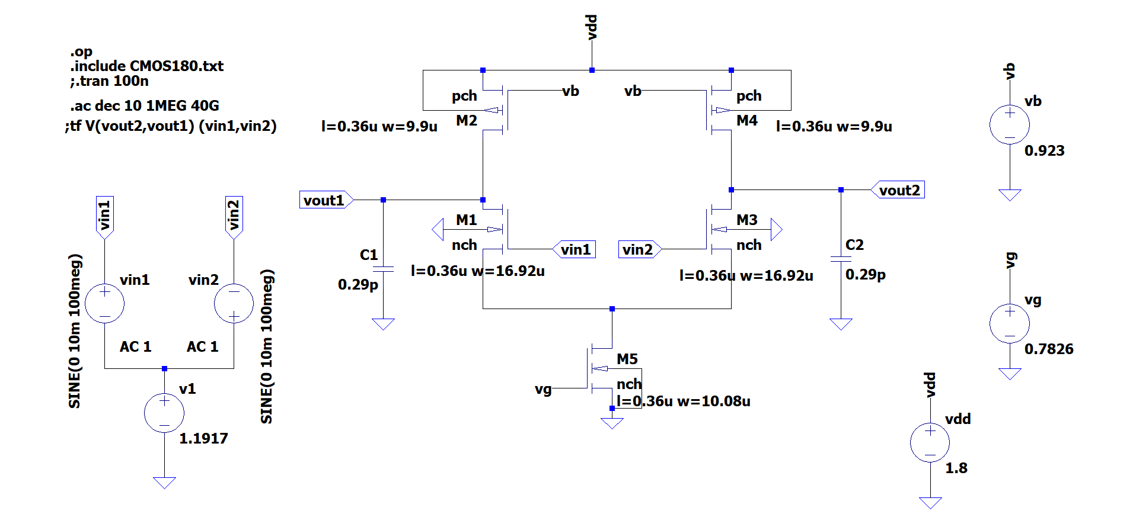
DIFFERENTIAL PAIR SCHEMATIC IN LT SPICE

Slide 28
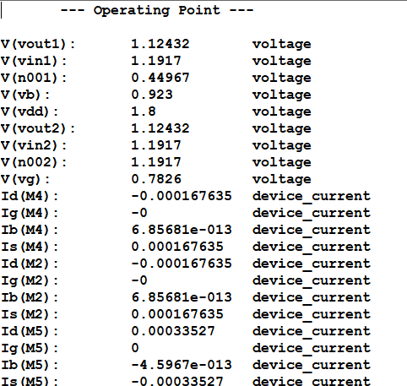
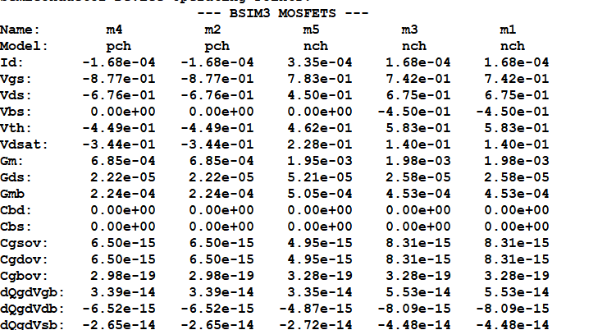
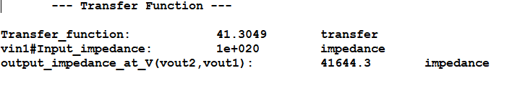
SPICE ERROR LOG & TRANSFER FUNCTION

Slide 29
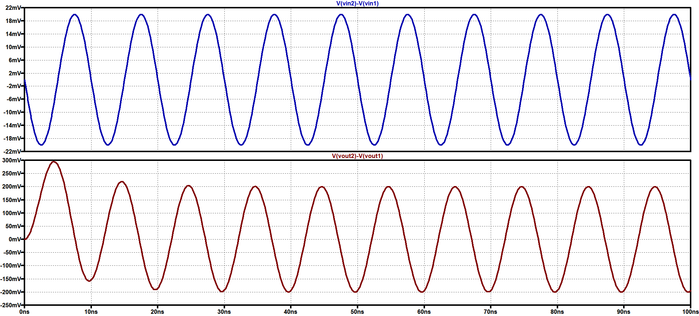
TRANSIENT ANALYSIS
Gain =10 at 100MHz , Input given is 10mV

Slide 30
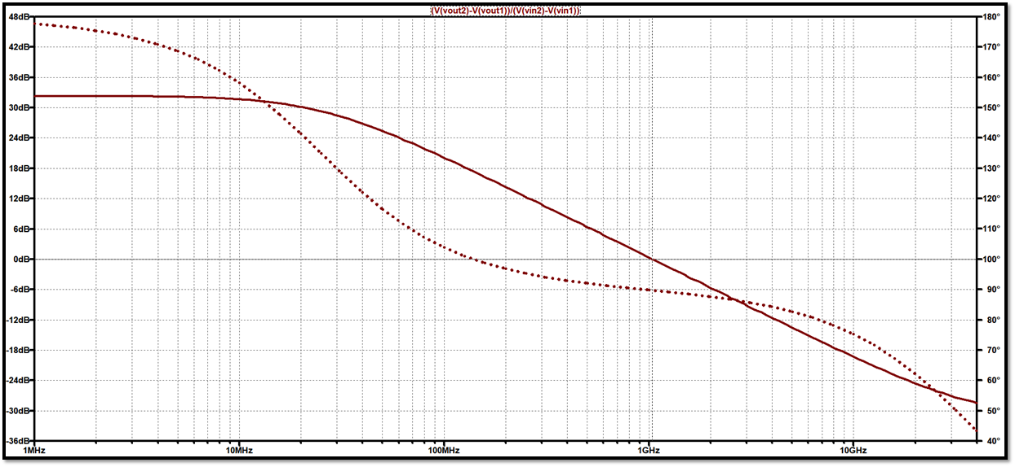
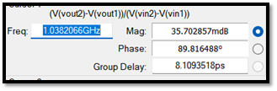
AC ANALYSIS
Gain ( In Decibel )
GBW=1.038 GHz
GBW=1.038 GHz
GBW=1.04 GHz
Frequency

Slide 31
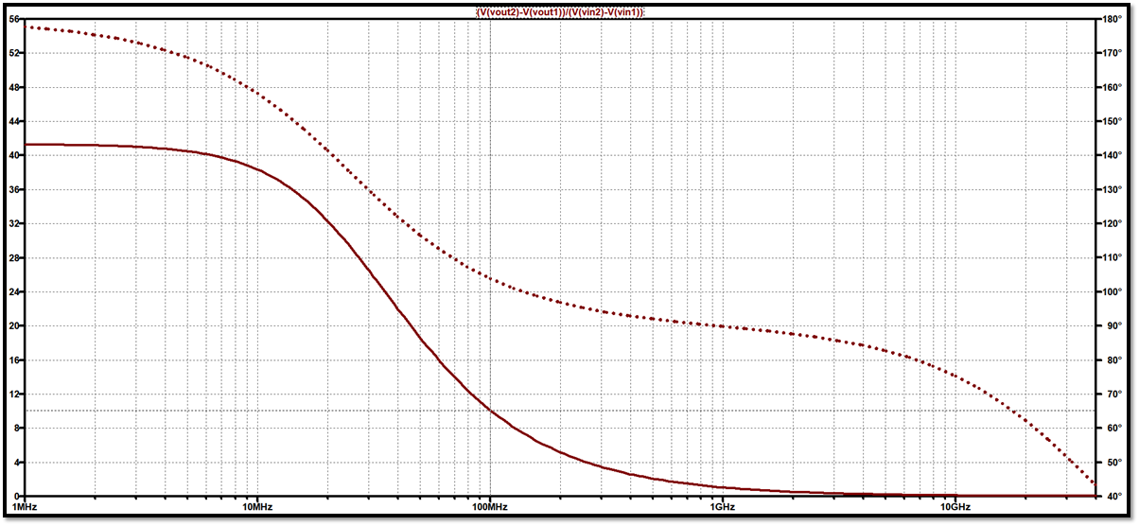
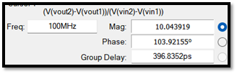
AC ANALYSIS
Gain ( In Volts/Volts )
Gain 10.043 at 100MHz
Gain 10.07 at 100MHz
Gain 10.043 at 100MHz
Gain 10.00498 at 100MHz
Frequency

Slide 32
SUMMARY OF DESIGN OF DIFFERENTIAL PAIR
SPECIFICATION | SIMULATION RESULTS
At 100MHz , Gain=10 | At 100MHz , Gain=10.04
GBW=1GHz | GBW=1.038GHz

Slide 33
SINGLE SATGE OPAMP DESIGN (Gm over Id Method)
DESIGN AND SIMULATION using lt spice
Model file : 180n
SPECIFICATIONS
GBW= 1GHz
Gain = 10 at 100 MHz frequency

Slide 34
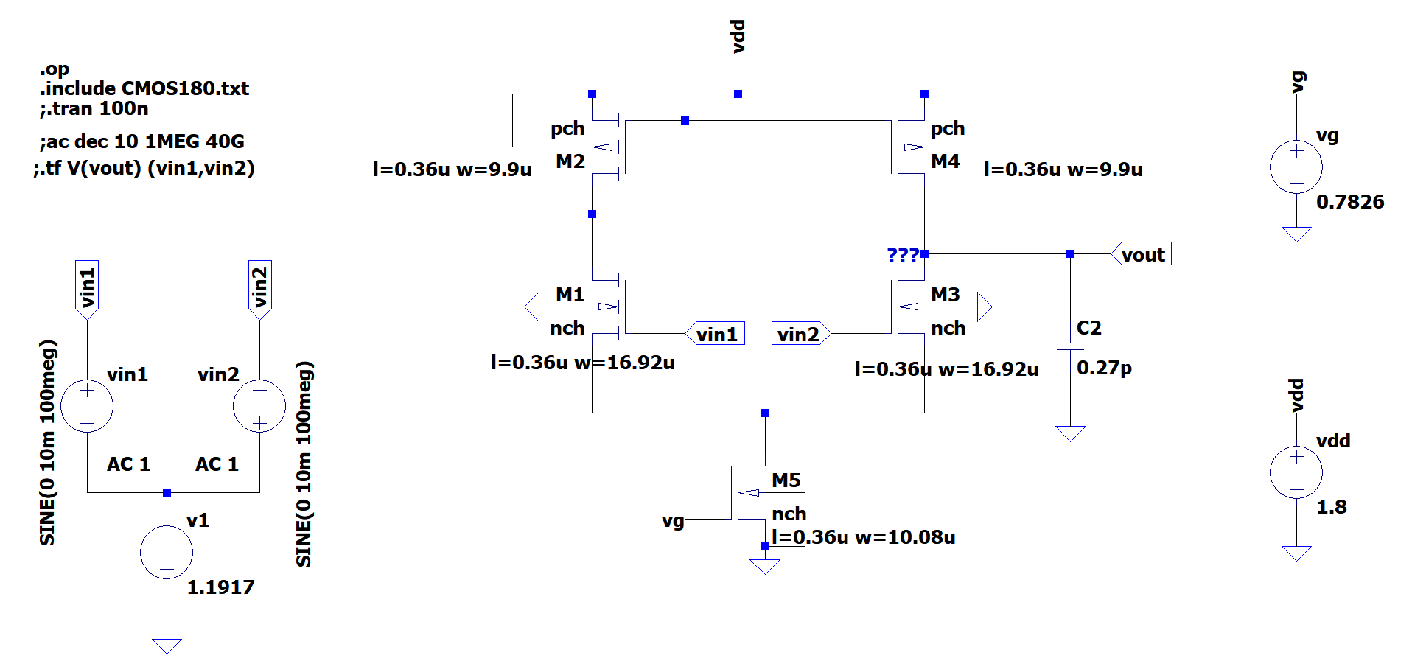
SINGLE STAGE OPAMP SCHEMATIC IN LT SPICE

Slide 35
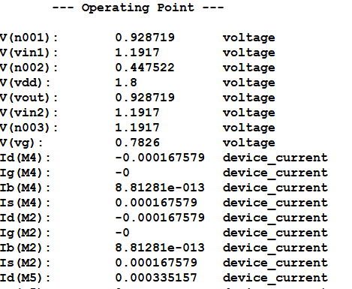
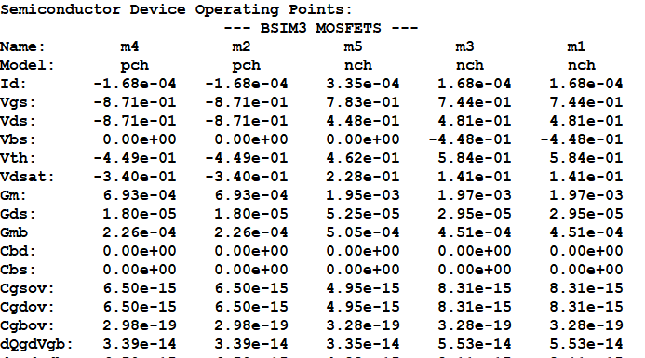
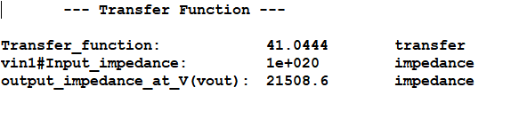
SPICE ERROR LOG & TRANSFER FUNCTION

Slide 36
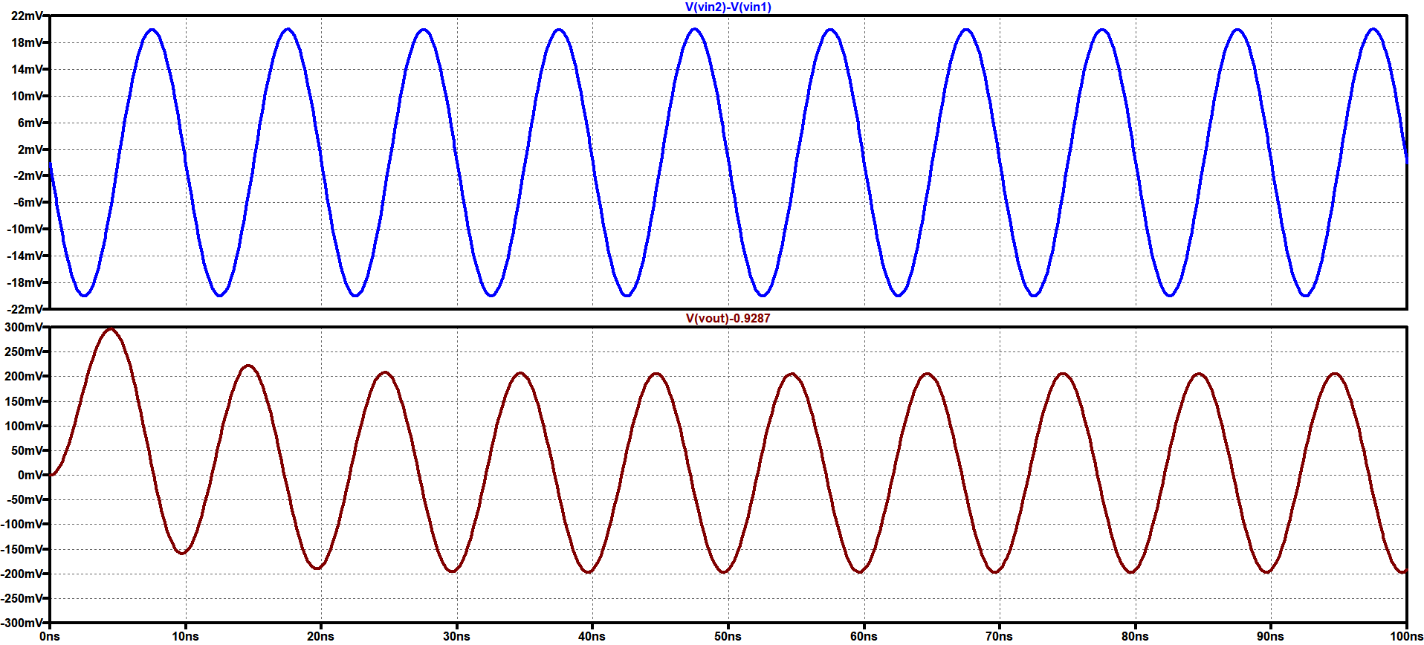
TRANSIENT ANALYSIS
Gain =10 at 100MHz , Input given is 10mV

Slide 37
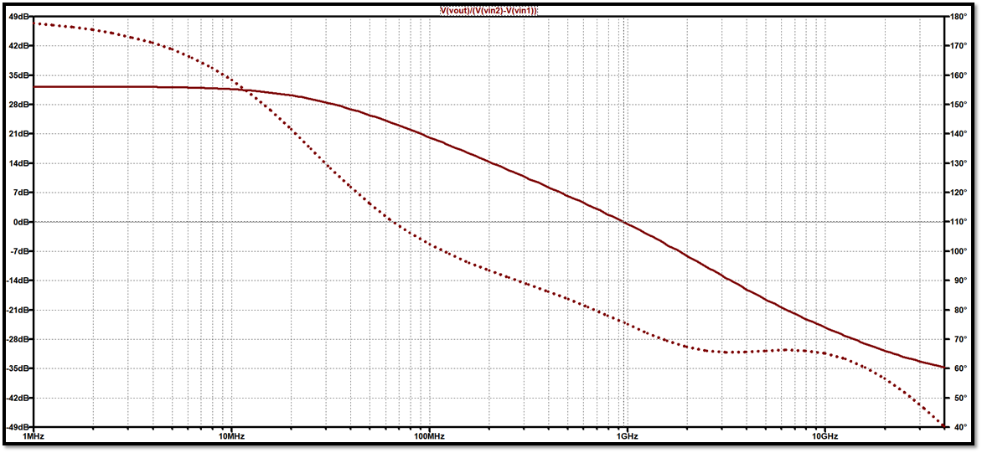
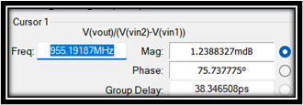
AC ANALYSIS
Gain ( In Decibel )
GBW=1.038 GHz
GBW=1.038 GHz
GBW=955MHz
GBW=955MHz
GBW=1.04 GHz
Frequency

Slide 38
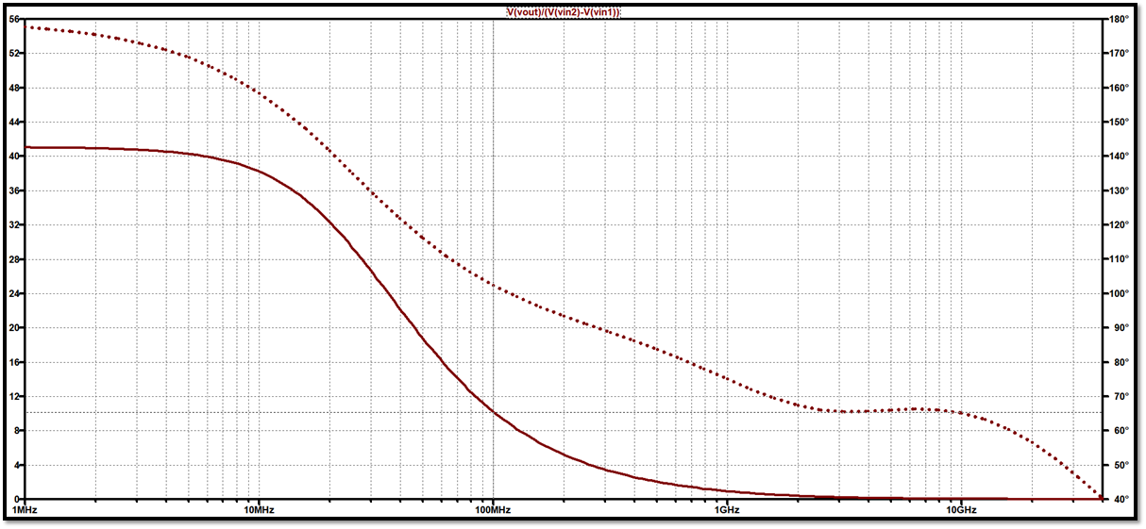
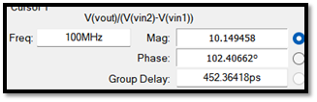
AC ANALYSIS
Gain ( In Volts/Volts )
Gain 10.043 at 100MHz
Gain 10.07 at 100MHz
Gain 10.043 at 100MHz
Gain 10.149 at 100MHz
Gain 10.00498 at 100MHz
Frequency

Slide 39
SUMMARY OF DESIGN OF SINGLE STAGE OPAMP
SPECIFICATION | SIMULATION RESULTS
At 100MHz , Gain=10 | At 100MHz , Gain=10.14
GBW=1GHz | GBW=955MHz

Slide 40
DESIGN OF TWO SATGE OPAMP (Gm over Id Method )
DESIGN AND SIMULATION using lt spice
Model file : 180n
SPECIFICATIONS
Gain > 60dB
CONSTRAINTS = (CL=20f , Phase Margin >50 Degree)

Slide 41

CALCULATIONS for FIRST STAGE
Gain = 40 , $\text{C}\text{L}$ =20f , Rout = 93 KΩ (Assumed after Back Calculations)
Let $Gm$= $\frac{Gain}{Rout}$ = 0.43mS
Taking $\frac{Gm}{Id}=12$ Id = $\frac{0.43mS}{12}$ = 35.83uA
For NMOS : (From Look Up Tables in ADT)
For $\frac{Gm}{Id}=12$ , $\frac{Gm}{Gds}=$77.05 , $\frac{Id}{W}=9.913$ , Vgs=0.7316
Hence , Gds= $\frac{0.43mS}{77.05}$ = 5.58uS W= $\frac{35.83u}{9.913}$ =3.6u and Vg =0.7316+0.45
Vg = 1.18
For PMOS :
As , Rout = Ro(NMOS) || Ro(PMOS) Gds(PMOS)= $\frac{1}{ROUT}$ - Gds(NMOS)
Hence , Gds(PMOS)= 5.172uS
Now , as current will remain same i.e 35.83uA
$\frac{Id}{Gds(PMOS)}=$ $\frac{35.83u}{5.17u}$=6.93 using this From LUT in ADT , Gm/Id is calculated for PMOS

Slide 42

Hence , $\frac{Gm}{Id}=5.487$ Gm (PMOS) = 5.487 * 35.83uA = 0.196mS
For $\frac{Gm}{Id}=5.487$ $\frac{Id}{W}=10.8$ Vsg=0.781
Hence , W= $\frac{35.83u}{10.8}$ = 3.317 (Taken 3.24u)
And Vb = 1.8 – 0.781 = 1.019
AS CL=20f BW (-3dB) = $\frac{Gm}{2πRout CL}=$85.56MHz

Slide 43
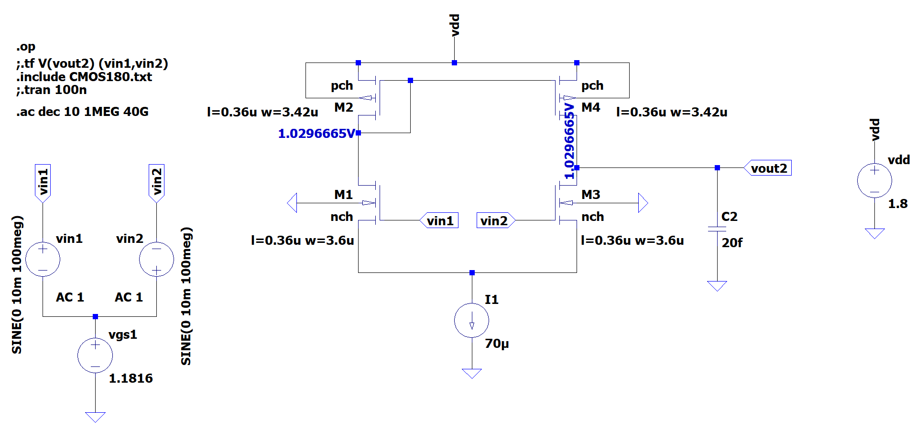
SCHEMATIC IN LT SPICE

Slide 44

CALCULATIONS for Next STAGE
( COMMON SOURCE USING PMOS AND CURRENT SOURCE LOAD )
Gain = 28 , $\text{C}\text{L}$ =20f
For PMOS :
Taking $Gm$= 8 * 0.43mS = 3.44 mS
As Av=Gm*Rout Rout = Av/Gm=8.139K
Vb(PMOS) = 1.0296 V Vsg=0.7704
From ADT , For Vsg =0.7704 Gm/Id is Calculated $\frac{Gm}{Id}=5.658$ Id=607.8U
Now , for above Gm/Id $\frac{Gm}{Gds}=47.92$ , $\frac{Id}{W}=10.51$
Hence , Gds = 71.7uS W = 57.84u
For NMOS :
As , Rout = Ro(NMOS) || Ro(PMOS) Gds(NMOS)= $\frac{1}{ROUT}$ - Gds(PMOS)

Slide 45

Hence , Gds(NMOS)= 48.5uS
Now , as current will remain same i.e 607.98uA
$\frac{Id}{Gds(NMOS)}$=12.534 using this From LUT in ADT ,
Gm/Id is calculated for NMOS
Hence , $\frac{Gm}{Id}=5.61$ Gm (PMOS) = 5.61 * 607.98uA = 3.41mS
For $\frac{Gm}{Id}=5.61$ $\frac{Id}{W}=36.7$ Vgs=0.7913
Hence , W= 16.56u

Slide 46
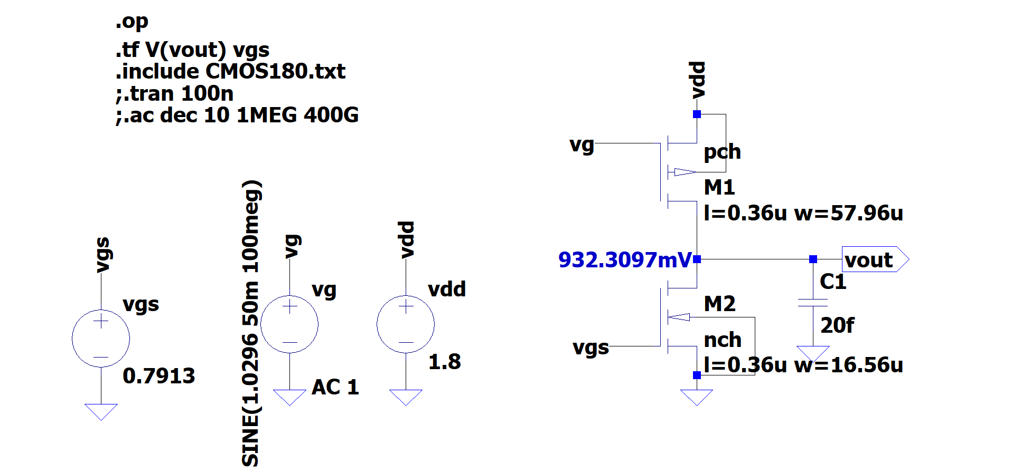
SCHEMATIC IN LT SPICE

Slide 47
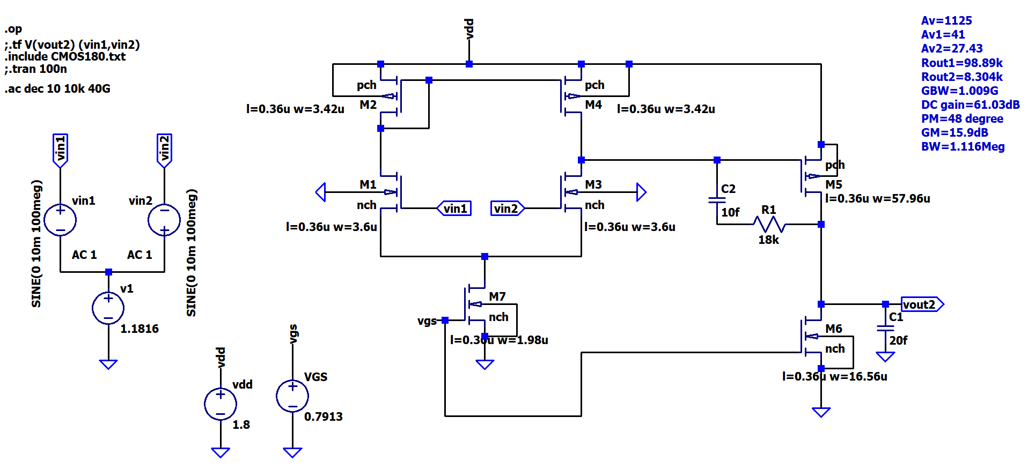
TWO STAGE OPMAP SCHEMATIC IN LT SPICE
47 degree

Slide 48
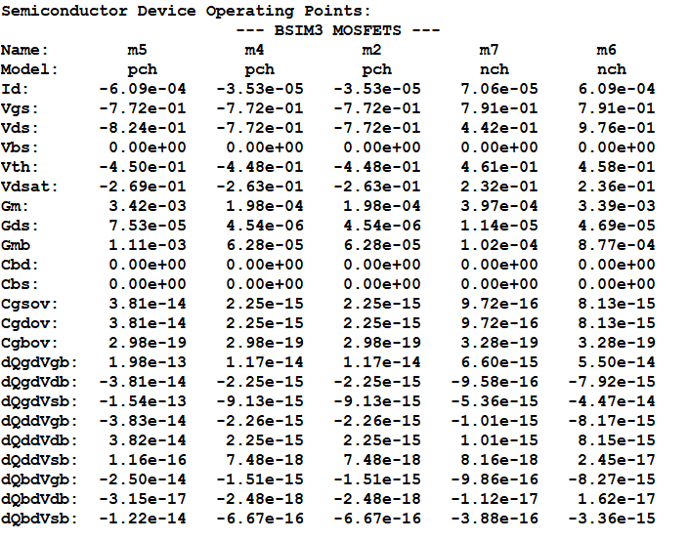
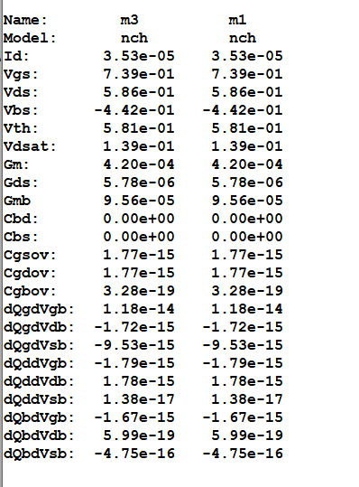
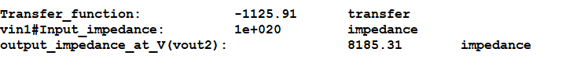
SPICE ERROR LOG AND TRANSFER FUNCTION

Slide 49
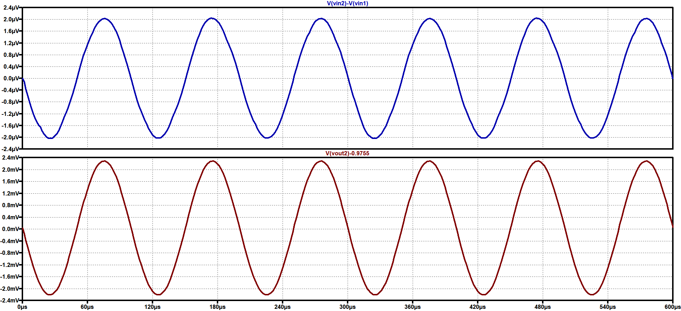
TRANSIENT ANALYSIS
Gain > 1000 at 10k , Input given is 1uV

Slide 50


AC ANALYSIS
Gain ( In Decibel )
GBW=1.038 GHz
GBW=1.038 GHz
GBW=955MHz
GBW=955MHz
GBW=1.04 GHz
GBW=1.01GHz
Gain Margin=47°
Frequency

Slide 51
SUMMARY OF DESIGN OF SINGLE STAGE OPAMP
SPECIFICATION | SIMULATION RESULTS
Gain>1000 i.e. 60dB | Gain=1125 i.e. 61.03dB
GBW=1GHz | GBW=1.01GHz
Phase Margin > 50° | Phase Margin = 47°

Slide 52
SUMMARY
Designed and Simulated Various Circuits using Gm over Id Method such as :
Common Source , Common Drain Amplifier , Current Mirror , CS Amplifier for Differential Pair Design , Differential Pair , Single Stage Op Amp , and Two Stage Op Amp
Software Used: LTspice, Analog Designer Toolbox (ADT)
Final Project: Design and Simulation of Two Stage Op Amp with Gain > 1000 (60 dB)
Results: All simulation results met the specifications.

Slide 53
SPECIAL THANKS TO :
Dr. Saif Abrar Sir
Prof . Mohammad Jawaid Siddiqui Sir
Mudassir Sir
Shamshul Haq Sir
Mohd Kashif Sir
And My Internship Partners
Munazir Reza
Ayush Sharma
Mohsin Husain
&
My Parents
THANK YOU !

